Slide 1
Global Education Policy and the Sustainable Development Goals:
Complexity, systems thinking and social justice
Professor Leon Tikly

Slide 2
Aims
Consider the relevance of complexity theory for the way that we conceptualise global education policy (GEP) in the context of the SDGs
Draw out some of the broad implications for researchers and policy-makers

Slide 3
Key arguments
Complexity theory (CT) provides a useful set of tools for better understanding the nature of global education policy in the context of the sustainable development goals.
Needs to be understood as a broad approach rather than a specific guide to policy-making.
CT needs to be set against an understanding of how power works in global governance.

Slide 4
Outline
Introducing SDGs
Challenges of the SDGs for policy makers
Understanding of SD and ESD too simplistic
Understanding of the basic policy cycle too simplistic
Introducing complexity theory
GEP from the perspective of CT
Understanding policy as complex systems
Globalization as a fitness landscape
Some implications for policy makers – adaptive problem solving
Some implications for research
Understanding policy making process
Understanding learning as a complex system

Slide 5
Introducing SDGs

Slide 7
By 2030, ensure that all girls and boys complete free, equitable and quality primary and secondary education leading to relevant and Goal-4 effective learning outcomes
By 2030, ensure that all girls and boys have access to quality early childhood development, care and preprimary education so that they are ready for primary education
By 2030, ensure equal access for all women and men to affordable and quality technical, vocational and tertiary education, including university
By 2030, substantially increase the number of youth and adults who have relevant skills, including technical and vocational skills, for employment, decent jobs and entrepreneurship
By 2030, eliminate gender disparities in education and ensure equal access to all levels of education and vocational training for the vulnerable, including persons with disabilities, indigenous peoples and children in vulnerable situations
By 2030, ensure that all youth and a substantial proportion of adults, both men and women, achieve literacy and numeracy
By 2030, ensure that all learners acquire the knowledge and skills needed to promote sustainable development, including, among others, through education for sustainable development and sustainable lifestyles, human rights, gender equality, promotion of a culture of peace and non-violence, global citizenship and appreciation of cultural diversity and of culture’s contribution to sustainable development
Build and upgrade education facilities that are child, disability and gender sensitive and provide safe, nonviolent, inclusive and effective learning environments for all
By 2020, substantially expand globally the number of scholarships available to developing countries, in particular least developed countries, small island developing States and African countries, for enrolment in higher education, including vocational training and information and communications technology, technical, engineering and scientific programmes, in developed countries and other developing countries
By 2030, substantially increase the supply of qualified teachers, including through international cooperation for teacher training in developing countries, especially least developed countries and small island developing states

Slide 8
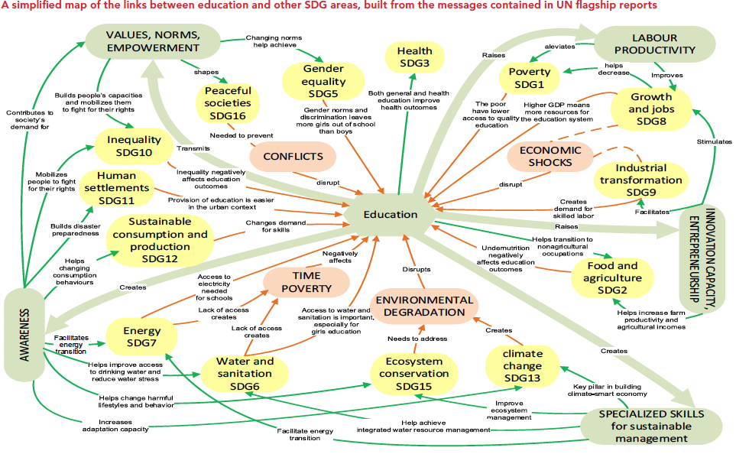

Slide 9
Defining SD: Bruntland (1987)
Humanity has the ability to make development sustainable to ensure that it meets the needs of the present without compromising the ability of future generations to meet their own needs. The concept of sustainable development does imply limits - not absolute limits but limitations imposed by the present state of technology and social organization on environmental resources and by the ability of the biosphere to absorb the effects of human activities.

Slide 10
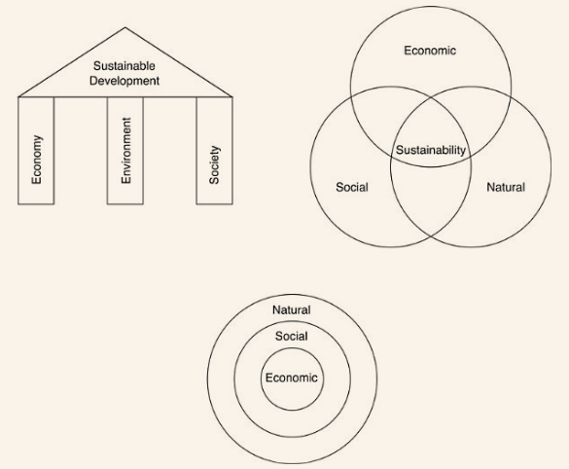

Slide 11
Common criticisms of dominant conceptions of SD
Vague- ‘meat-fix’, ‘all things to all people’, ‘floating signifier’
‘Sustainable development’ is an oxymoron
Does not specify the relationship between different components of SD
Elides power relationships between countries and groups
Ahistorical – ignore colonial legacy and effects of globalisation
Eurocentric
Limited theory of change or of human agency

Slide 12
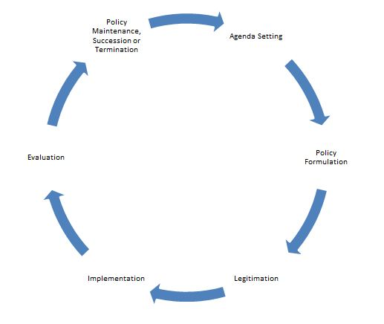

Slide 14
Complexity theory
“Complexity science developed earlier and faster in the natural sciences (Capra 1997; Waldrop 1992) than the social sciences. This was partly due to the incorporation of simple equilibrium concepts of systems in the early founding texts of sociology, such as those by Durkheim and Parsons, which have been strongly criticized. These criticisms of simple equilibrium conceptualizations of systems tended to lead to rejection of the concept of system altogether rather than to its revision and gradual improvement. This was part of the turn against the ‘metanarrative’ (Lyotard 1978); away from modernism, and towards postmodern and poststructuralist perspectives in social science.”Excerpt From: Sylvia Walby. “Crisis.” iBooks.

Slide 15
Complexity theory
A complex system cannot be explained merely by breaking it down into its component parts because those parts are interdependent: elements interact with each other, share information and combine to produce systemic behaviour.
The behaviour of complex systems is difficult (or impossible) to predict. They exhibit ‘non-linear’ dynamics produced by feedback loops in which some forms of energy or action are dampened (negative feedback) while others are amplified (positive feedback). Small actions can have large effects and large actions can have small effects.
Complex systems are particularly sensitive to initial conditions that produce a long-term momentum or ‘path dependence’.

Slide 16
Complexity theory continued
They exhibit emergence, or behaviour that evolves from the interaction between elements at a local level rather than central direction. This makes the system difficult to control (and focuses our attention on the rules of interaction and the extent to which they are adhered to).
They may contain ‘strange attractors’ or demonstrate extended regularities of behaviour which are ‘liable to change radically’. They may therefore exhibit periods of ‘punctuated equilibria’ – in which long periods of stability are interrupted by short bursts of change.
The various ‘wicked problems’ that complexity theory seeks to address – such as predicting climate change, earthquakes, the spread of disease among populations, the processing of DNA within the body, how the brain works, the growth of computer technology and artificial intelligence, and the behaviour of social and political systems – can only be solved by interdisciplinary scientific groups.

Slide 17
What are systems?
A system is self-reproducing, repetitive and self-organizing.
Generic terms in the social sciences for this concept of system include social system and socio-technical system, while more specialized terms include society, capitalism, regime, gender regime, institution, field, domain and social formation.
“The concept of ‘fitness landscape’ is introduced by Kauffman (1993) to address the uneven nature of the ‘landscape’ or terrain on which systems interact and compete. Changes in the nature of the landscape may benefit one system but at the same time disadvantage other systems. The fitness of the landscape can differently affect the success or otherwise of the varied systems within it; some entities may flourish while others will not.”
Walby, 2015

Slide 18
Globalisation
There are uneven global flows of capital, trade, and people, an uneven development of global institutions, networks and hegemons, and global civil societal waves – not a single uniform process of globalization.
These flows, institutions, and waves involve the coevolution of economies, polities, violence, and civil societies – there is no simple one-way impact of the economic on the rest that might be successfully or unsuccessfully resisted.
There is the restructuring rather than the annihilation of space.
There are emergent forms of global civil societal practices as well as glocalization in which cultures are framed by the global – not the homogenization of culture.

Slide 19
Globalisation
Globalization has occurred before – it is neither only new nor only old, but it is taking new and deeper forms.
While some polities, especially states, are losing power to larger forces, this is not uniform – there are contesting global hegemons, especially the USA and the European Union, as well as the emergence of global institutions.
There are global civil societal waves – including neoliberalism, socialism, human rights, feminism, environmentalism, and religious fundamentalisms.
Neoliberalism is a powerful global project that has become embedded in some governmental programmes and social formations – it is not the same as globalization, nor is it fully hegemonic.
There are competing projects of societalization on a global scale, but none has overwhelmed the others – currently the most important are the contesting projects of modernity associated with the hegemons of the USA and the EU. Global societalization projects cannot be understood without their gender, ethnic, national, and religious components.

Slide 20
Power in global governance
Here Barnett and Duvall’s (2004) definition of power as “the production, in and through social relations, of effects that shape the capacities of actors to determine their own circumstances and fate”
They define compulsory power as comprising the relations of interaction that allow one actor to have direct control over another. In the context of the focus of this book, this is see for example in the conditionalities imposed by donors on recipients of aid. It is also reflected in the inability of low and middle income countries to hold donor countries to account for the amount of aid our for the nature of the aid relationship.
A second type of power is institutional in which states design international institutions in ways that work to their long-term advantage and to the disadvantage of others. In relation to the development of discourses around education and development it is manifest in the historical dominance of the interests of powerful, Western nations and private sector interests in the governance structures of global financial institutions such as the World Bank (Jones 2006, 2007a; Mundy and Verger 2015).
Thirdly, structural power, concerns the constitution of social capacities and interests of actors in direct relation to one another. One expression of this form of power is the working of the global capitalist economy in producing unequal social relations of production between capital and labor. Regimes of inequality based on class relationships of dominance and subordination in international relationships also intersect in complex ways with those of gender, culture, and race (e.g., Rupert 2009; Walby, 2013).
Finally, productive power is the socially diffused production of subjectivity in systems of meaning and signification, including the way that “development” itself is defined and understood. Following Foucault (1989), global policy discourses have their own ‘productive power’ (see also Barnett and Duval, 2004a; 2005; Tikly, 2016)

Slide 21
System change
A crisis is a potential ‘tipping point’ or ‘critical turning point’ in a system. It is a point at which there is potential for change in the wider system. There is a lack of proportion between cause and consequence. While there is the potential for change, it is not necessary that this potential is realized for it to be termed ‘crisis’. However, the terms ‘tipping point’ and ‘critical turning point’ are only used when there is actual change. The more popular term is that of ‘tipping point’ (Gladwell 2000). There is a range of substantively oriented concepts in the social sciences which encompass this meaning, including those of disaster, catastrophe and revolution, as already discussed. Excerpt From: Sylvia Walby. “Crisis.” iBooks.

Slide 22
Regimes of inequality
There are several regimes of complex inequality, including those of class, gender, and ethnicity. These are complex inequalities, combining inequality and difference simultaneously.
They are analytically distinguishable; different forms of complex inequality are not reducible to each other within one social system, although they intersect and mutually adapt.
Each regime of inequality involves all institutional domains of economy, polity, violence, and civil society, as well as macro, meso, and micro levels.
Multiple regimes of inequalities, including those of gender, class, and ethnic relations, coexist within the institutional domains of economy, polity, violence, and civil society, which establish the ontological depth of the regime.
Each regime of inequality has ontological depth because of its constitution in this range of institutional domains and levels of abstraction.
Rather than an a priori theoretical assumption of the close coupling of these regimes and institutions, there is an empirical question to investigate as to the internal cohesion of each regime of inequality and their intersection.
Walby (2009)

Slide 23
What is global education policy?
Start form Ball et al’s (2013) understanding of policy as ‘socially constructed enactments that span text and practice’. That is encompasses systems of meaning and signification and systems of practice.
GEP comprises both ‘meta-discourses’ that shape what can be thought and rules and formalised rules and regulations.
GEP needs to be understood as involving the co-evolution (articulation) of systems operating at different scales from the global to the local
At a global level GEP involves the operation of policyscapes (Carney, 2009) that set discursive parameters on policy, e.g. dominant conceptions of SD/ ESD as well as their formalisation in the SDGs. Policy at a global level is undertaken by epistemic communities operating within a regime of organisations in the education issue area.
At a regional level, global policy discourses are mediated by regional bodies including, eg. AU, SADC, ADEA etc.
At a national level GEP is further mediated by local contexts and processes of policy formulation, influence and practice

Slide 24
Complex realism
The concept of complex realism building on critical realism combines the notion that there are procedures by which knowledge claims are contested (subject to refutation) and can be improved with that of uncertainty, in that they can never be known absolutely. In complex realism, the testing of knowledge claims against a network of theories and empirical evidence can lead to a reduction in the errors in knowledge.

Slide 25
Methods
The aim is to ‘hunt down causation’,
Inter-disciplinarity as a means to tackle ‘wicked problems’
It is a theory of change (ontology) that is being investigated
RCTs are often preferred as the ‘gold standard’ but can these cope with complexity?
Other quant methods such as MLM and SEM are often preferred
Genuinely mixed methods have been found to be useful (i.e. qual not simply hand maiden of quant)
Methodologies including PAR and knowledge co-production have a good ‘fit’ with CT

Slide 27
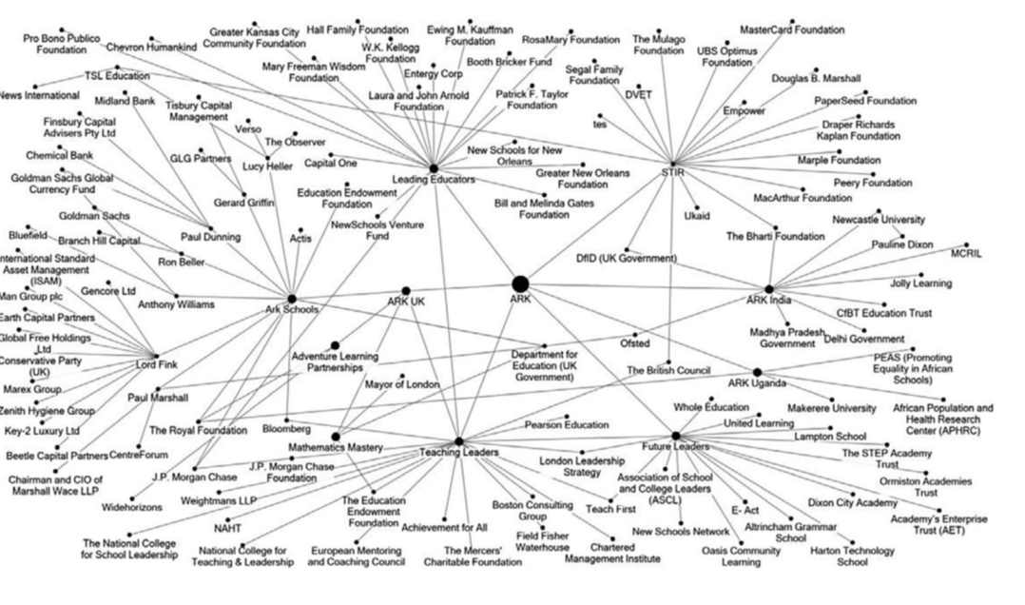

Slide 29
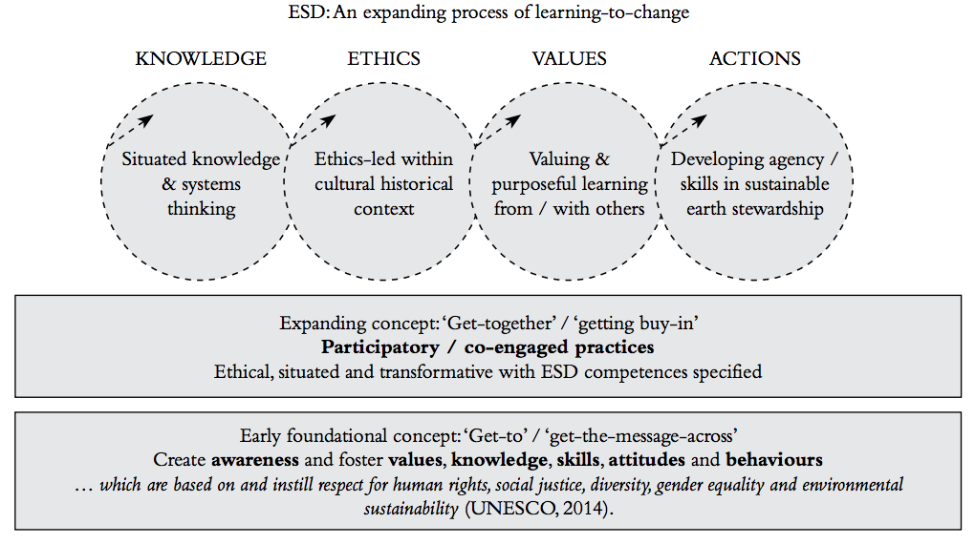

Slide 30
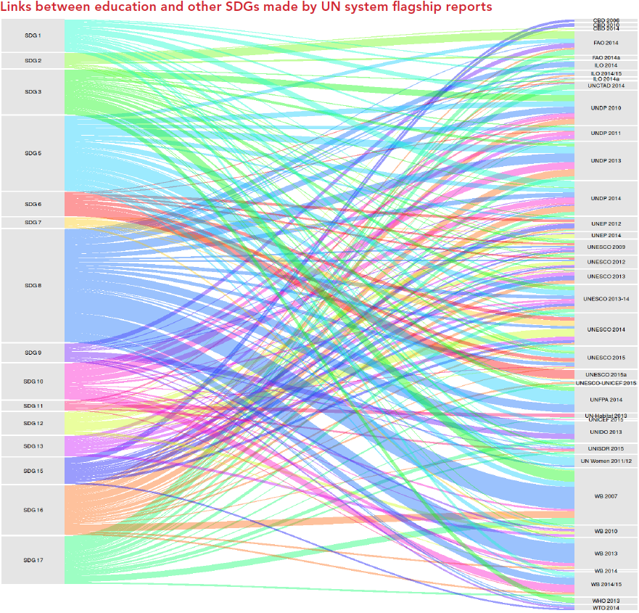

Slide 31
